Slide 1
PHISHING URL DETECTION SYSTEM
PROJECT TITLE
BY
SIMON NZESI MUTUA
BSC SOFTWRE ENGINEERING

Slide 2
PROBLEM STATEMENT
Phishing has been around and it continues to present a substantial risk to businesses as well as individuals .
The concern is driven by increasingly sophisticated attacks; the move from email to alternative attack vectors, such as social media and messaging (sharing of URLs), the increase in Work-from-home situations, online education, and entertainment via online platforms – brought by COVID-19 pandemic.
Current methods used for detecting phishing attacks are usually based on either blacklisting or whitelisting techniques. Therefore, there is a need for an intelligent method for identifying phishing URLs and reduce phishing attacks

Slide 3
Objectives
The main goal of this study is to develop an efficient phishing detection system to allow a user who visits a URL on the Internet determine whether a URL is a phishing or legitimate one by ensuring high accuracy levels while reducing the average computational cost.
To develop a phishing detection system that promptly alerts the user in case of a phishing instance.
Design a browser extension that is capable to handle real-time scenarios and zero-day attacks.

Slide 4
Proposed Solution
The proposed solution is a browser extension framework that works at the client side (browser) of the user accessing web pages from the internet.
The basic idea is to use machine learning algorithms on available datasets of phishing webpages to generate a model which can be used to make classifications in real time if a given web page is a phishing site or a legitimate webpage.
The training model will be built using python and then testing done using Javascript.

Slide 5
Related systems
The solutions that have been proposed in literature and in industry for detecting phishing web pages can be grouped into three main categories:
User education and training
Server-side software solutions
e.g. Email content analysis, notice and takedown method,
Client-side software solutions
e.g. blacklist-based methods (SmartScreen by Microsoft), visual-clue based (Visible watermarking).

Slide 6
Methodology
This study employs the use of evolutionary model of software development. Evolutionary model suggests breaking down of work into smaller chunks, prioritizing them and then delivering those chunks.
The choice of this methodology comes handy due to the time factor involved; the project was estimated to run for a period of ten weeks which is a major constraint in the development.
The use of the iterative model also allowed for instant modification upon and during development and in addition the application can be altered easily.

Slide 7
Results
This paper led to the production of a Chrome extension that complies to the Google norms for detecting phishing URLs.
The browser extension predicts the URL’s nature based on the following categories of URL features:
Address Bar based features
Abnormal based features
HTML and JavaScript based features
Domain based features

Slide 8
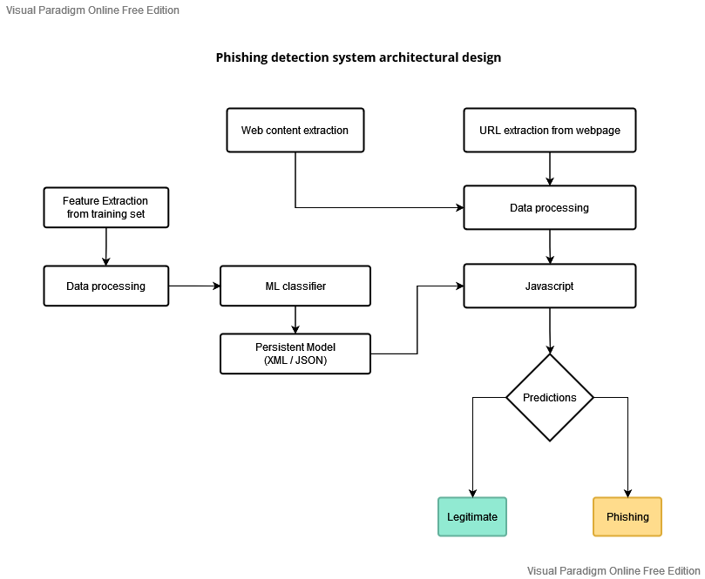
Results continuation
The extension works based on the following structure:

Slide 9
Conclusion
Based on the research objectives and research findings, the following conclusions are drawn:
The phishing detection system guarantees security of the end user by sending a pop up alert window to notify the user when a phishing instance is detected while they are visiting various web pages.
The system is capable of handling future phishing attack methods which have not been updated on phishing data sites such as the Phishtank. This is because the system analyses the URL features and patterns commonly used by phishers and then learns from such URLs to detect new attack vectors.

Slide 10
Recommendations
For future enhancements this paper makes the following recommendations to the system :
Conversion of the browser extension to browser independent and cross-platform plugin.
Build the phishing detection system as a scalable web service which will incorporate online reporting by experienced IT users so that new phishing attack patterns can easily be learned and improve the accuracy of the models with better feature extraction by taking into account every new phishing pattern introduced by phishers.

Slide 11
References
Bergholz, A., Chang, J. H., Paass, G., Reichartz, F., & Strobel, S. (2008, August). Improved Phishing Detection using Model-Based Features. In CEAS.
Chandrasekaran, M., Narayanan, K., & Upadhyaya, S. (2006, June). Phishing email detection based on structural properties. In NYS cyber security conference (Vol. 3).
Kirda, E., & Kruegel, C. (2005, July). Protecting users against phishing attacks with antiphish. In 29th Annual International Computer Software and Applications Conference (COMPSAC'05) (Vol. 1, pp. 517-524). IEEE.
N. Chou, R. Ledesma, Y. Teraguchi, and J. C. Mitchell, “Client-side defense against web-based identity theft,” in NDSS. The Internet Society, 2004.

